Slide 1
ML WORKSHOP DAY-2

Slide 2
WHAT DO YOU THING
HOW MACHINE LEARNING MODEL LEARN?

Slide 3
What Are The Types Of ML Systems
01
Based on Supervision
02
Incremental Learning
03
Instance and Model based

Slide 4
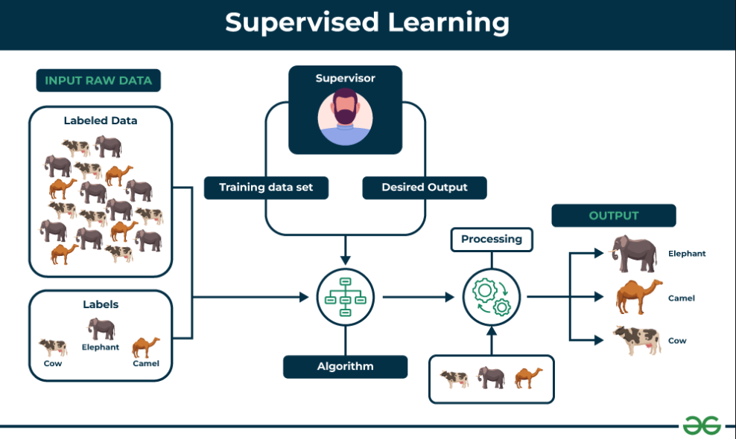
Based On supervision
Supervised learning is defined as when a model gets trained on a "Labelled Dataset". Labelled datasets have both input and output parameters.
There are two main categories of supervised learning that are mentioned below:
1. Classification: deals with predicting categorical target variables.
2. Regression : predicting continuous target variables, which represent numerical values.

Slide 5
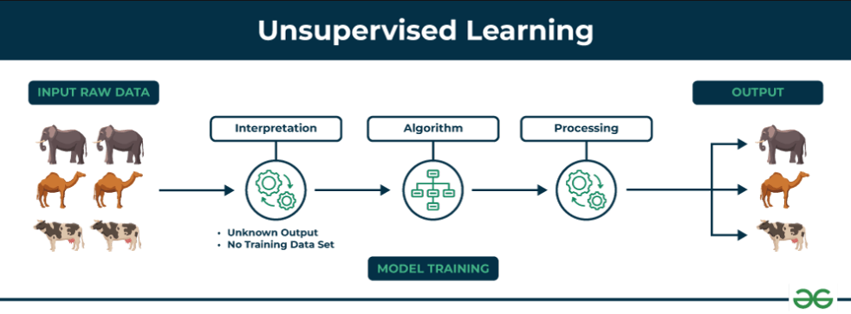
Based On supervision
Unsupervised Learning Unsupervised learning is a type of machine learning technique in which an algorithm discovers patterns and relationships using unlabeled data.
The primary goal of Unsupervised learning is often to discover hidden patterns, similarities, or clusters within the data.
There are two main categories of unsupervised learning that are mentioned below:
1.Clustering : process of grouping data points into clusters based on their similarity. 3.Association : technique for discovering relationships between items in a dataset.

Slide 6
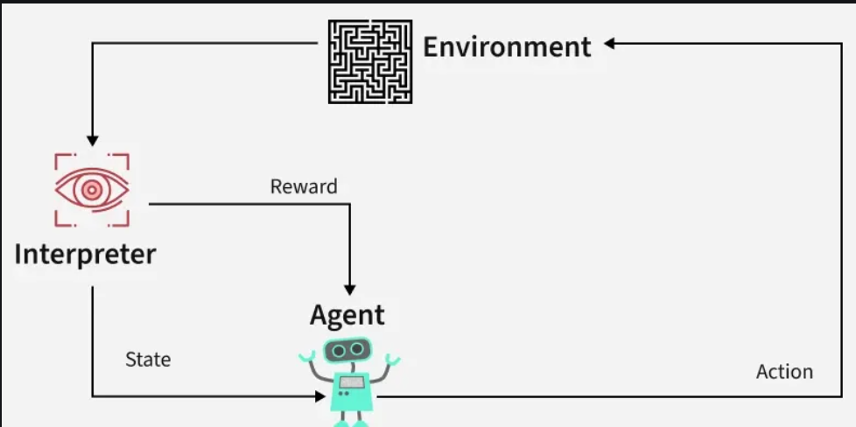
Based On supervision
Semi-Supervised learning is a machine learning algorithm that works between the supervised and unsupervised learning so it uses both labelled and unlabelled data. It's particularly useful when obtaining labeled data is costly, time-consuming, or resource-intensive.
Reinforcement machine learning algorithm is a learning method that interacts with the environment by producing actions and discovering errors. Trial, error, and delay are the most relevant characteristics of reinforcement learning.

Slide 7
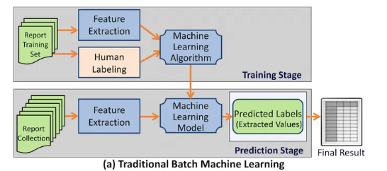
Batch Vs Online Learning
Batch learning : also known as offline learning, involves training a machine learning model on a complete, fixed dataset all at once.
This approach requires the entire dataset to be available before training begins, and the model is typically trained in bulk.
Once trained, the model is deployed and does not learn from new data unless it undergoes a complete retraining process with a new dataset.
This method is well-suited for scenarios with stable, static data where high accuracy and convergence are paramount, such as predictive maintenance using historical sensor data.

Slide 8
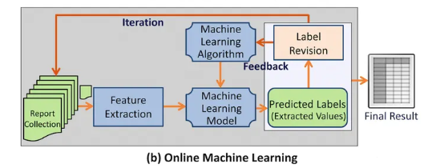
Batch Vs Online Learning
Online learning : is a continuous, incremental approach where the model learns from data as it arrives in a stream.
Instead of waiting for a complete dataset, the model updates its parameters after processing each new data point or a small batch of data.
This allows the model to adapt dynamically to new information and changing data distributions, making it highly effective in environments with real-time data, such as high-frequency trading or recommendation systems.

Slide 9
Pros & Cons
Batch Learning
Pros:
High Accuracy
Stable
Efficient Optimization
Cons:
Hardware intensive.
Inflexible for new data.
Online Learning
Pros:
Real-time Adaptation.
Lower memory.
Quick output
Cons:
Lower initial accuracy
Complex tuning

Slide 10
Instance Vs Model Learning
Instance-based learning : also known as lazy learning, involves storing the training data instances and making predictions by comparing a new input to these stored examples based on similarity measures like distance.
The most common algorithm in this category is the k-nearest neighbors (k-NN) method.
model-based learning: focuses on creating a generalized mathematical model from the training data that captures the underlying patterns and relationships.
This model, once trained, can make predictions on new data without needing to reference the original training instances, resulting in faster prediction times and lower storage requirements.

Slide 11
WHAT IS TRAINING A MODEL MEANS?

